Slide 1
Week 01- Introduction to Management

Slide 2
Module Data
GPA
2 Credits
30 Hours-Lectures
15 Hours-Tutorials

Slide 3
Aim & Objectives
Enrich the students with fundamental knowledge required for supporting management information systems and managerial decision making
To enhance the student’s awareness, and knowledge about the working context in an organization

Slide 4
Learning Outcomes
At the end of the module the student will be able to:
Recognize organizational environment and apply management theories
Identify the skills needed by managers and managerial roles
Recognize the importance of human resource management and motivation theories
Apply economic principles in day to day business operations

Slide 5
Outline Syllabus
Introduction to Management
Introduction to Organization and Organization Environment
Managerial Decision Making and Problem Solving
The Process of Planning
The Process of Organizing
The Process of Leading (Motivation, Leadership and Communication)
The Process of Controlling
Introduction to Economics (Scarcity, Markets, Functions and Equilibrium)
Demand, Supply and Market Equilibrium
Un-Employability and Inflation

Slide 6
Assessment & weighting
Continuous assessment
In class discussions, group work, quizzes, assignments & tutorials - 50%
End Semester Examination
Structure Exam Paper- 50 %

Slide 7
1. Introduction to Management

Slide 8
Contents
What is management?
Management as a process
Management is an Art or a Science?
Core concepts of management
Why management?
Who is a Manager?
Managerial roles

Slide 9
Management in Business Organisations
Business
Management
Organisation

Slide 10
What is Management? There is no universally accepted definition of Management.

Slide 11
Different Definitions of Management

Slide 12
Management Definitions
Definition – 1
Management is the art of getting things done through
other people.
Mary Parker Follet (1868-1933)
Definition – 2
Management is the art of getting things done through and with people in formally organized group.
(Koontz)

Slide 13
Management Definitions
Definition – 3
Management is the process of planning, organising, commanding, coordinating and controlling.
(Fayol,1930)
Definition – 4
Management is the process of planning, organising, leading and controlling, the efforts of organisation members and of using all other organisational resources to achieve organisational goals.
(Stoner and Freeman,2009)

Slide 14
Management Definitions
Definition – 5
Management is the attainment of organisational goals in an effective and efficient manner through planning, organising, leading and controlling organisational resources.
(Daft,2012)

Slide 15
Hence, Management can be broadly defined as a process of planning, organizing, leading and controlling the limited resources efficiently and effectively to achieve predetermined goals and objectives in an ever changing business environment.

Slide 16
Management in Organisations
Environment
Planning
Organizing
Inputs from the environment
•
Human resources
Goals Attained
•
Financial resources
•
Efficiently
•
Physical resources
•
Effectively
•
Information resources
Controlling
Leading
(Source: Adapted from Van Fleet, David D., Contemporary Management, Second Edition.)

Slide 17
Core Concepts of Management
Resources
Efficiency
Effectiveness
Productivity
Process
Goals/Objectives
Environment
( Core Concept is a notion or an idea, and in this context it refers to the key terms used to define and understand what management is?)

Slide 18
Resources
An organisation’s resources include;
Human Resources
Financial Resources
Physical Resources
Information Resources
Time
Etc.

Slide 19
Efficiency
“Doing things right”
(Drucker,2010)
The ability to minimize the use of resources in achieving organisational objectives.
(Stoner and Freeman, 2009)
Getting the most output from the least amount of inputs.
(Robbins and Coulter, 2012)
A measure of how well or how productively resources are used to achieve a goal.
(Jones and George, 2009)

Slide 20
Effectiveness
“Doing the right thing”
(Drucker,2010)
The ability to determine appropriate objectives.
(Stoner, Freeman and Gibert, 2008)
A measure of the appropriateness of the goals an organisation is pursuing and of the degree to which the organisation achieves those goals.
(Jones and George, 2009)

Slide 21
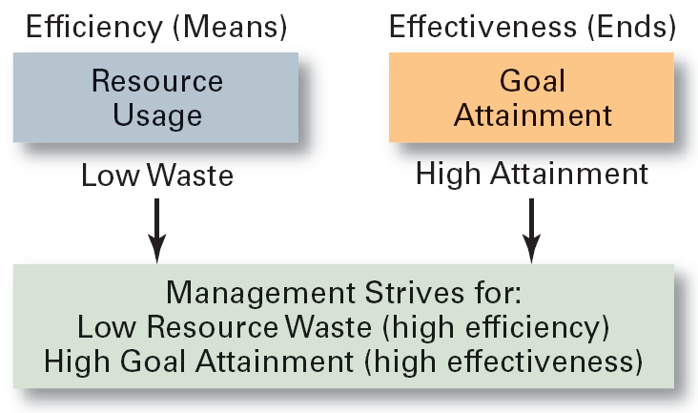
Efficiency and Effectiveness in Management
(Robbins and Coulter, 2012)

Slide 22
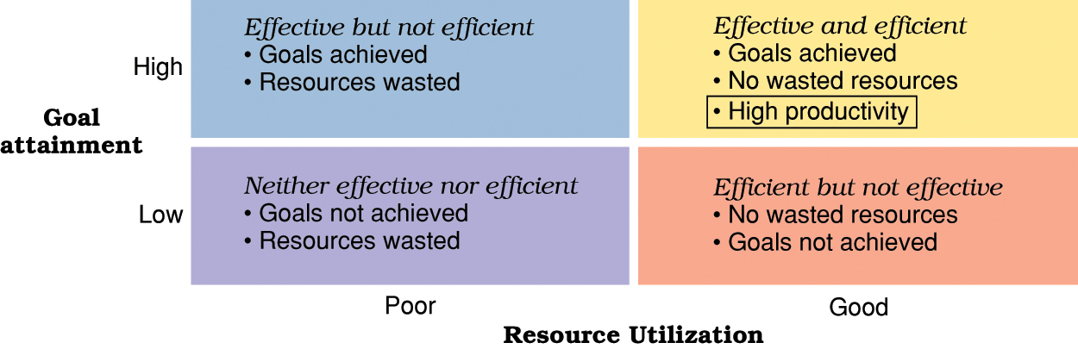
High Performing Organisations are Effective and Efficient
(John R. Schermerhorn)

Slide 23
Productivity
Productivity is the relationship between the output generated by a production or service system and the input provided to create this output.
Productivity = Efficiency + Effectiveness

Slide 24
Management – as a Process
Planning
Organizing
Leading
Controlling

Slide 25
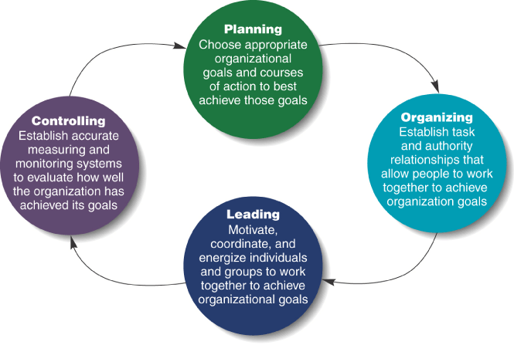
Four Functions of Management
(Jones and George, 2008)

Slide 26
Management Is it a Science or an Art?

Slide 27
Management as a Science
Science is a body of knowledge pertaining to a specific field of study. It contains theories, principles and facts.
Management as an Art
Art implies the application of knowledge and skills to bring about the desired results.
Management is both a science as well as an art.
Science(theory) and art (practice) are both essential for the success of management.

Slide 28
Why Management?
To maximize the utilization of scarce resources
To face the increasing competition for inputs and outputs
To enhance the quality of the products and services
To adopt/plan for the changes in the business environment
The ultimate aim of management is to enhance the organisational productivity and performance.

